Slide 1
Ninja Ball
A pinball inspired platformer

Slide 2
Overview
Embark on a Quest to the top of the tower to defeat the evil shogun.
Fun levels full of pinball inspired obstacles.
Fast paced platforming.
No death penalty to retain a sense of quick progression.
Notes:
Ninjaball will see you progressing up a series of increasingly challenging levels to reach the top of the tower, the levels will use the vertical space
Provided by the phone screen to progress onwards, using the environment to your advantage to move through the level. We decided on a pinball theme as we liked the visual and mechanical elements that a pinball game can have with this kind of platformer.

Slide 3
Gameplay
All levels will have the player start at the bottom of the level and attempt to move up to the top of the screen.
Platforming will rely on the various obstacles to propel the player through the level.
Notes:
We realised that many of the design features seen in pinball games could be used on this kind of platformer to promote fun fast paced gameplay,
Flippers, bumpers and springs could be used as obstcales or as a means to move through the level

Slide 4
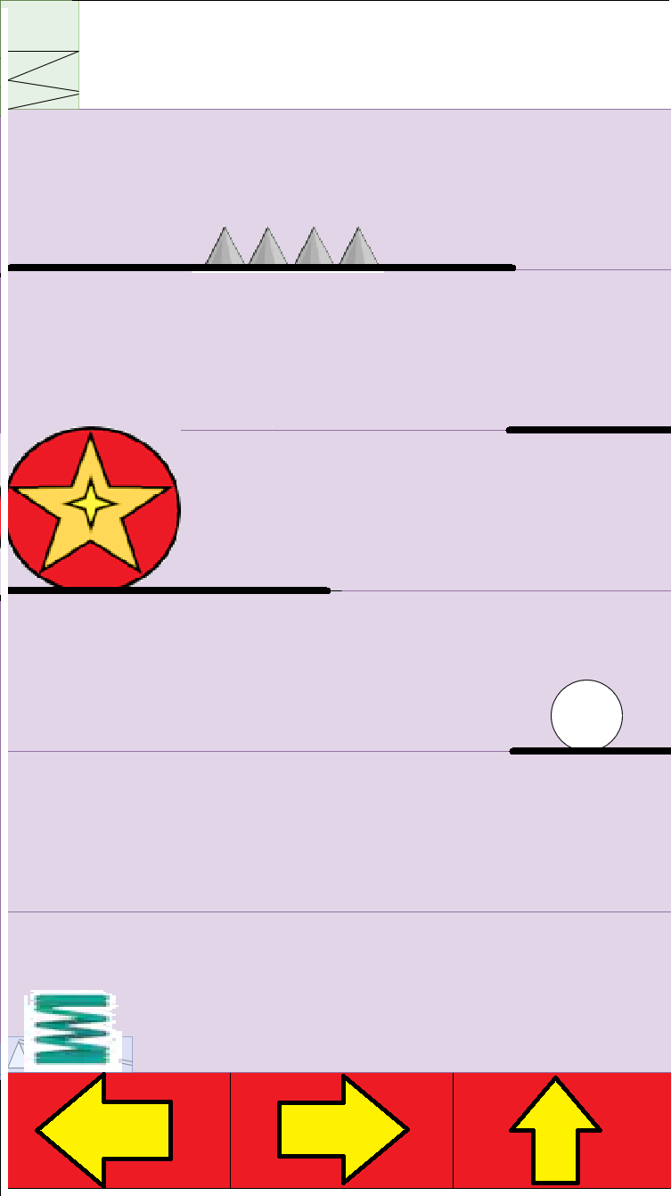
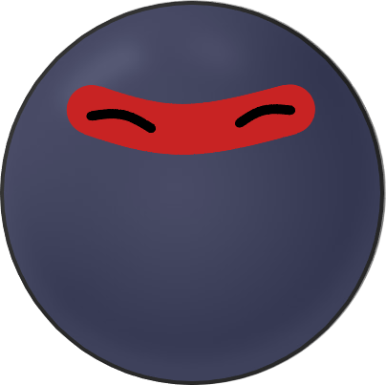
Character design and controls
Vertical phone screen.
3 buttons: left, right and jump.
Easy mid air control.

Slide 5

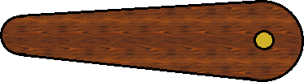
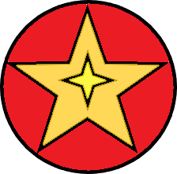
Obstacles
spikes kill on contact.
flippers throw player in a given direction.
bumper bounces the player back.
spring fires player into next level.

Slide 6
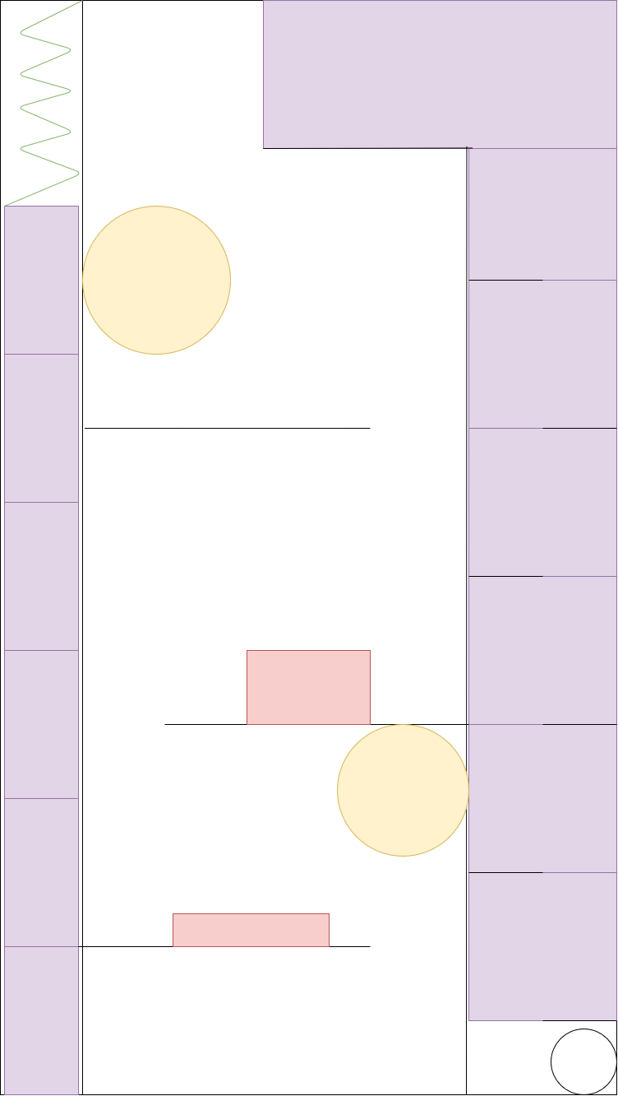
Level design
Tight compact levels using more verticality than normally seen in a platformer.
<various level designs including boss level>

Slide 7

Audio
Bumper sound
Flipper sound
Level transition

Slide 8
Staff
Tomas Crowley
Dawid Kocik
Ronan McMorrow
Oscar Bogenberger
Elliot Cleary

Slide 9
Risks
Possible issues in maintaining a consistent level size.
Not much experience in Corona could be unforeseen technical difficulty.
Possible difficulty in making a sufficient amount of content

